Slide 1

Dobrodošli !

Slide 2
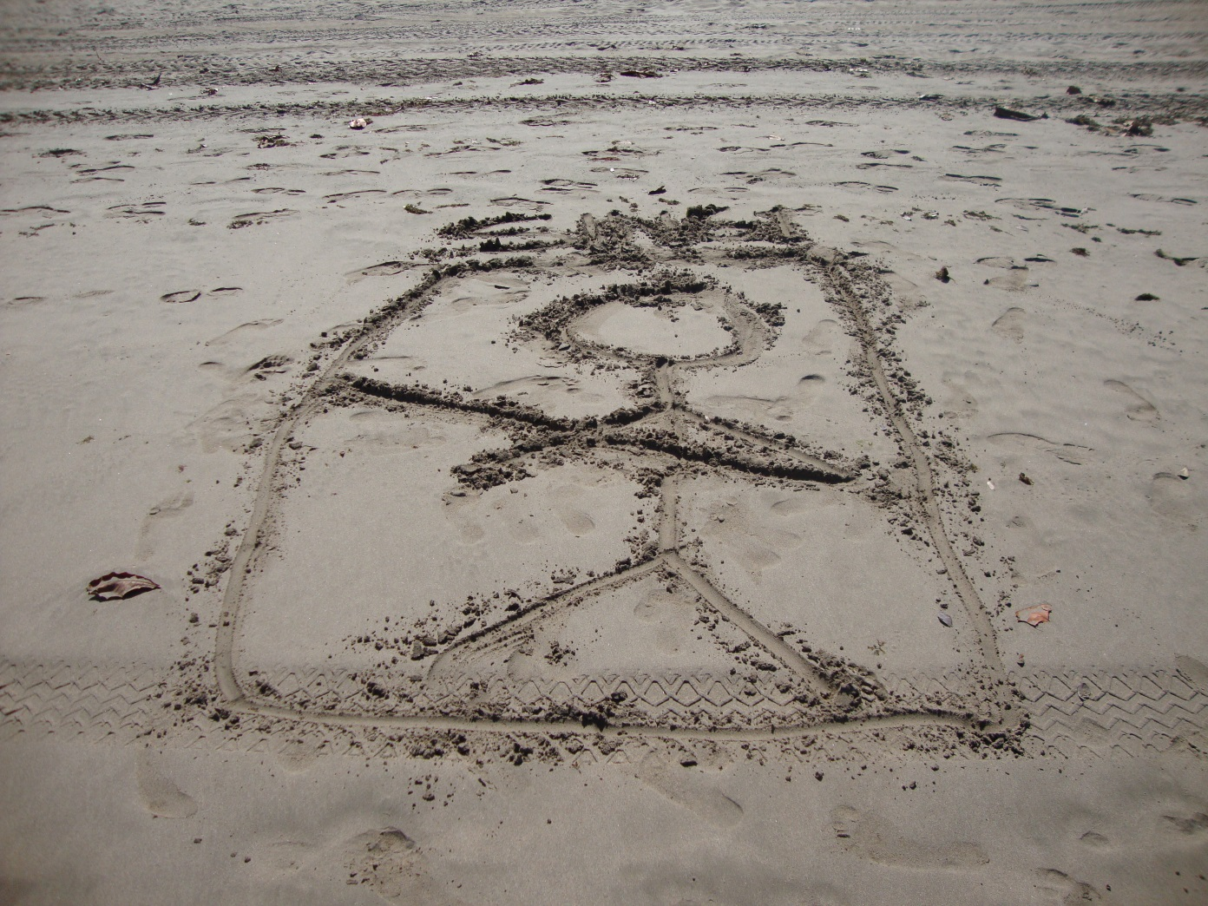
KASPERSKY ENDPOINT SECURITY 10 FOR BUSINESS
Zeljko Nikolic
Technical support
Singi Inzenjering

Slide 3
Novi tipovi pretnji, novi vidovi zaštite !
200K
New Threats Every Day
>35K
Malicious programs specifically targeting mobile devices
>100m
Malware files in Kaspersky Lab collection Jan 2013
1999
2001
2003
2005
2007
2009
2011
2013
Notes:
Malware continues to grow exponentially. We are now seeing more than 200,000 new malware samples every single day.
It’s true: Cybercriminals are accelerating their production of malicious software.
But now – they’re expanding beyond their traditional methods and are using different vectors. A case in point – we are now tracking over 35,000 different malicious programs designed specifically to target mobile devices like smart phones and tablets.
As of January 2013, Kaspersky’s malware collection contains over 100 million threats. Just two years ago, that number was only 50 million.
Malware is not a small problem.

Slide 4

Uticaj na IT !
Malware
Response:
Anti-malware plus management tool / dashboard
The #1 target: applications!
Response:
Systems / patch management
Your data is on
the move!
Your data
Response:
Data encryption
Mobile / BYOD
Response:
Mobile device
management (MDM)

Slide 5
Kompleksnost !
Malware
The #1 target: applications!
1
platform
management console
cost
Your data is on
the move!
Your data
Mobile / BYOD

Slide 6
Jedna paltforma jedno rešenje !
  Anti-malware
  traditional & cloud-assisted
Mobile security
MDM plus mobile security agent
  Systems
  Management
  including patch
  management
Data encryption
file / folder,
full-disk
  Endpoint
  control tools:
  application, device
  and web control

Slide 7
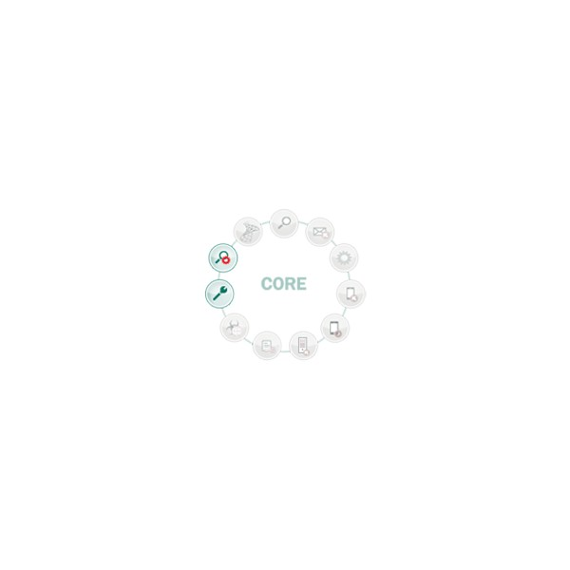
Kaspersky Endpoint Security 10 Core
Anti-Malware
Firewall
KSN
KSC

Slide 8
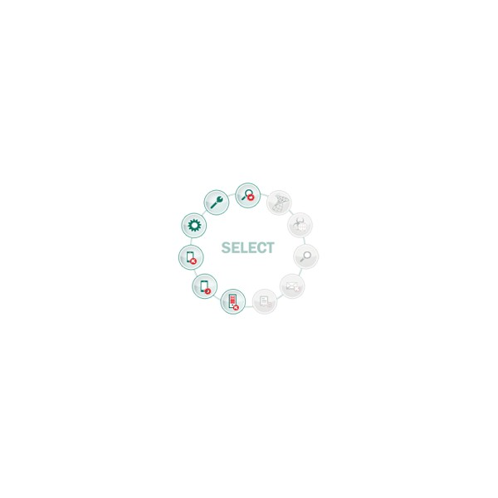
Kaspersky Endpoint Security 10 Select
Anti-Malware
Firewall
KSN
KSC
Application Control
Application Whitelist
Web Control
Device Control
File Server Protection
MDM
Mobile Endpoint Sec.

Slide 9

Kaspersky Endpoint Security 10 Advanced
Anti-Malware
Firewall
KSN
KSC
Application Control
Application Whitelist
Web Control
Device Control
File Server Protection
MDM
Mobile Endpoint Sec.
Encryption
Systems Management
Adv. Vuln. Scan
Patch Management

Slide 10
Paketi: Core, Select, Advanced
CORE
SELECT
ADVANCED
Anti-Malware
Firewall
KSN
KSC
Anti-Malware
Firewall
KSN
KSC
Application Control
Application Whitelist
Web Control
Device Control
File Server Protection
MDM
Mobile Endpoint Sec.
Anti-Malware
Firewall
KSN
KSC
Application Control
Application Whitelist
Web Control
Device Control
File Server Protection
MDM
Mobile Endpoint Sec.
Encryption
Systems Management
Adv. Vuln. Scan
Patch Management

